Slide 1


Noida Institute of Engineering and Technology, Greater Noida
ARM ARCHITECTURE FOR IoT
UNIT-V
APPLICATION DEVELOPMENT AND COMMUNICATION USING ARM
Dr. Zatin Gupta
Associate Professor
B. Tech Fifth Semester
(Internet On Things)

Slide 2
UNIT-V | APPLICATION DEVELOPMENT AND COMMUNICATION USING ARM
Overview, Data Transmission, Serial Communication Specifics, Error Detection, Software Structure – Handling asynchronous Communication & Parsing Messages, SPI Communications, I2C Communications, KL25Z I2C Controller, MMA8451 on Freedom KL25Z. Use case design study of Smart lighting in Smart cities using ARM processor.

Slide 3
Application development process: Overview
For a successful product, a well defined ARM based IoT system development process is critical.
10 STEP IOT SYSTEM DEVELOPMENT PROCESS
Ideation/purpose of the product
Technical specification
Architecting the Solution
Component section & design finalization
Test Plan
Design implementation
PoC / Prototype Development
Field Trials
Final Product Improvements
Product Release

Slide 4
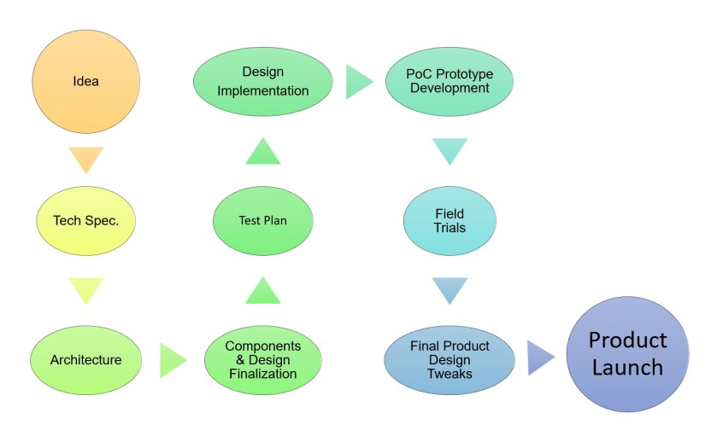
Application development process: Overview

Slide 5
data transmission
Data transmission is the transfer of data from one digital device to another. This transfer occurs via point-to-point data streams or channels.
These channels may previously have been in the form of copper wires but are now much more likely to be part of a wireless network.
As project know, data transmission methods can refer to both analog and digital data

Slide 6
Data Transmission
The data transfer schemes always want for sending information to the processor, rather receiving information from the ARM processor. It is so because sending and receiving information in the entire ARM data transfer scheme process plays a vital role for executing the entire program rather process.
The communication is not done directly with the Input Output device. The communication processes are carried out systematically by the help of Input Output device by the virtue of an Input Output port.
The data transfer can be either in two forms namely parallel or serial respectively. By the virtue of the Programmed Input Access or rather transferring data in parallel the data transfer can be possible by using the Input Output programmed ports.

Slide 7
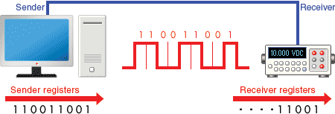
Serial Communication
Serial communication is a communication method that uses one or two transmission lines to send and receive data, and that data is continuously sent and received one bit at a time.
Since it allows for connections with few signal wires, one of its merits is its ability to hold down on wiring material and relaying equipment costs.
serial communication is the process of sending data one bit at a time, sequentially, over a communication channel or computer bus.

Slide 8
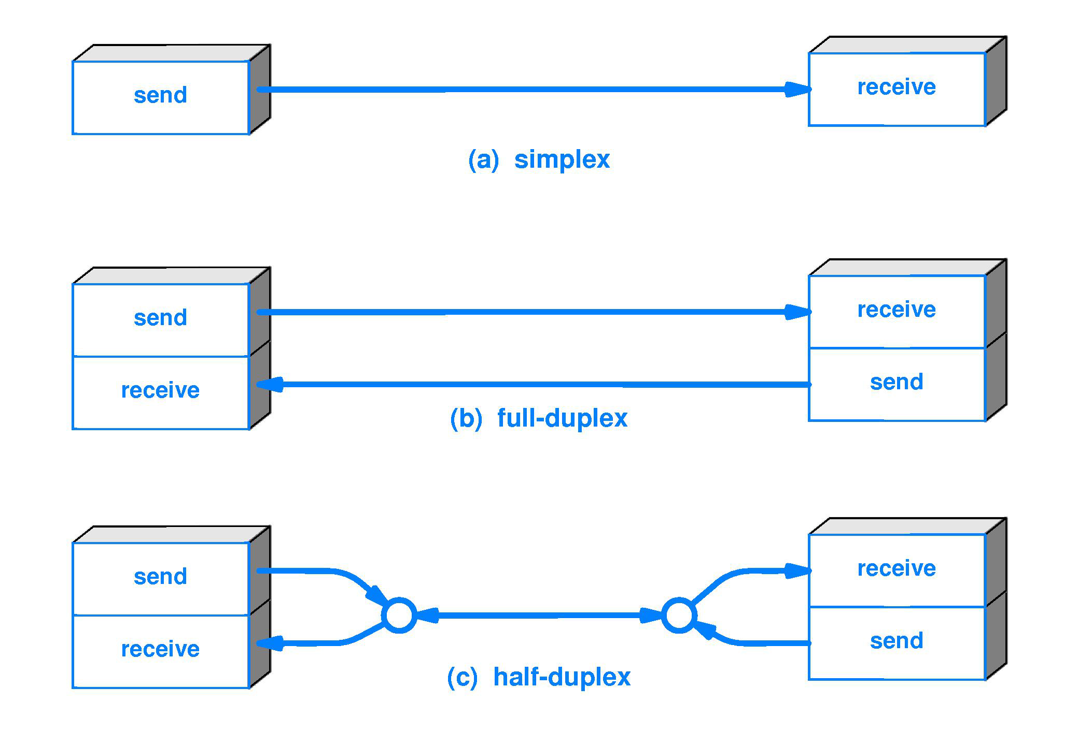
Serial Communication types

Slide 9
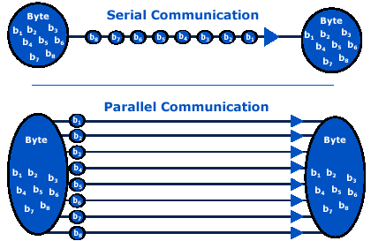
Serial vs Parallel Communication
S.NO | Serial Transmission | Parallel Transmission
1. | In this type, a single communication link is used to transfer data from one end to another | In this type, multiple parallels links used to transmit the data
2. | In serial transmission, data(bit) flows in bi-direction. | In Parallel Transmission, data flows in multiple lines.
3. | Serial Transmission is cost-efficient. | Parallel Transmission is not cost-efficient.
4. | In serial transmission, one bit transferred at one clock pulse. | In Parallel Transmission, eight bits transferred at one clock pulse.
5. | Serial Transmission is slow in comparison of Parallel Transmission. | Parallel Transmission is fast in comparison of Serial Transmission.
6. | Generally, Serial Transmission is used for long-distance. | Generally, Parallel Transmission is used for short distance.
7. | The circuit used in Serial Transmission is simple. | The circuit used in Parallel Transmission is relatively complex.
8. | Serial Transmission is full duplex as sender can send as well as receive the data | Parallel Transmission is half-duplex since the data is either send or receive
9. | Converters are required in a serial transmission to convert the data between internal and parallel form | No converters are required in Parallel Transmission
10. | Serial transmission is reliable and straightforward. | Parallel transmission is unreliable and complicated.

Slide 10
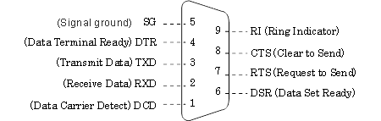
Serial communication standard-RS232
RS-232 is a serial communication standard is widely used and is often equipped on computers as standard. Its has connectors DB-9.

Slide 11
Serial communication Protocol-UART
UART, or universal asynchronous receiver-transmitter, is one of the most used device-to-device communication protocols.
This article shows how to use UART as a hardware communication protocol by following the standard procedure.
When properly configured, UART can work with many different types of serial protocols that involve transmitting and receiving serial data.
In serial communication, data is transferred bit by bit using a single line or wire.
In two-way communication, project use two wires for successful serial data transfer.
Depending on the application and system requirements, serial communications needs less circuitry and wires, which reduces the cost of implementation.

Slide 12
Serial communication Protocol-UART
By definition, UART is a hardware communication protocol that uses asynchronous serial communication with configurable speed. Asynchronous means there is no clock signal to synchronize the output bits from the transmitting device going to the receiving end.

Slide 13
UART-Features
For UART and most serial communications, the baud rate needs to be set the same on both the transmitting and receiving device. The baud rate is the rate at which information is transferred to a communication channel.
Wires | 2
Speed | 9600, 19200, 38400, 57600, 115200, 230400, 460800, 921600, 1000000, 1500000
Methods of Transmission | Asynchronous
Maximum Number of Masters | 1
Maximum Number of Slaves | 1

Slide 14
UART packet/Frame
Start Bit:To start the transfer of data, the transmitting UART pulls the transmission line from high to low for one (1) clock cycle.
Data Frame:The data frame contains the actual data being transferred. It can be five (5) bits up to eight (8) bits long if a parity bit is used. If no parity bit is used, the data frame can be nine (9) bits long.

Slide 15
UART-Data Transmission
Parity: Parity used for Error detection it describes the evenness or oddness of a number. The parity bit is a way for the receiving UART to tell if any data has changed during transmission.
After the receiving UART reads the data frame, it counts the number of bits with a value of 1 and checks if the total is an even or odd number. If the parity bit is a 0 (even parity), the 1 or logic-high bit in the data frame should total to an even number.
If the parity bit is a 1 (odd parity), the 1 bit or logic highs in the data frame should total to an odd number.
When the parity bit matches the data, the UART knows that the transmission was free of errors. But if the parity bit is a 0, and the total is odd, or the parity bit is a 1, and the total is even, the UART knows that bits in the data frame have changed.
Stop Bits: To signal the end of the data packet, the sending UART drives the data transmission line from a low voltage to a high voltage for one (1) to two (2) bit(s) duration.

Slide 16
UART-Data Transmission
Start Bit
Parity Bit
(0 because odd parity)
Stop Bit
8 bit Data

Slide 17
Parsing Messages in UART
Parsing is processes of receiving data via protocol and making massage as it was originally.
It is code written for controlling packets communication to prevent data loss.
UART use following for correct message parsing:-
RS-232 signalling (CTS, RTS, DSR and DTR)
Start and Stop signalling
Rx buffer at receiver side

Slide 18
UART receiver for message parsing used in KL-25z

Slide 19
KL-25z UART
Features of the UART module in KL-25z include:
Full-duplex, standard non-return-to-zero (NRZ) format
Double-buffered transmitter and receiver with separate enables
Programmable baud rates (13-bit modulo divider)
Transmit and receive baud rate can operate asynchronous to the bus clock:
Baud rate can be configured independently of the bus clock frequency
Supports operation in Stop modes
Configurable receiver buad rate oversampling ratio from 4x to 32x
Interrupt, DMA or polled operation.
Hardware parity generation and checking
Programmable 8-bit, 9-bit or 10-bit character length
Programmable 1-bit or 2-bit stop bits
Receiver wakeup by idle-line, address-mark or address match
Optional 13-bit break character generation / 11-bit break character detection
Selectable transmitter output and receiver input polarity

Slide 20
UART transmitter block diagram for Handling asynchronous Communication in KL-25z

Slide 21
UART Control Registers in ARM
The UART includes registers to control baud rate, select UART options, report UART status, and for transmit/receive data.
Bit | Work | Bit | Work
LOOPS | Loop Mode Select | TIE | Transmit Interrupt Enable
DOZEEN | Doze Enable (Wait mode) | TCIE | Transmission Complete Interrupt Enable for TC
RSRC | Receiver Source Select | RIE | Receiver Interrupt Enable
M | 1 Means 9-Bit data 0 means 8-Bit data | ILIE | Idle Line Interrupt Enable for IDLE
WAKE | Receiver Wakeup Method Select | TE | Transmitter Enable
ILT | Idle Line Type Select | RE | Receiver Enable
PE | Parity Enable | RWU | Receiver Wakeup Control
PT | Parity Type (0 Even, 1 Odd) | SBK | Send Break

Slide 22
Serial peripheral interface (SPI)
Serial peripheral interface (SPI) is one of the most widely used interfaces between microcontroller and peripheral ICs such as sensors, ADCs, DACs, shift registers, SRAM, and others.
SPI is a synchronous, full duplex Master-Salve based interface. The data from the main or the sub-node is synchronized on the rising or falling clock edge.
Both Master(main) and Salve(subnode) can transmit data at the same time. The SPI interface can be either 3-wire or 4-wire.

Slide 23
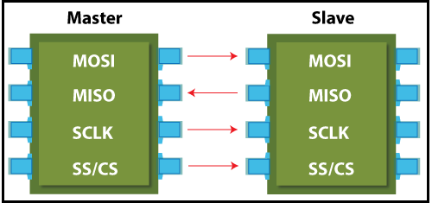
SPI-Interface
MOSI: MOSI stands for Master Output Slave Input. It is used to send data from the master to the slave.
MISO: MISO stands for Master Input Slave Output. It is used to send data from the slave to the master.
SCK or SCLK (Serial Clock): It is used to the clock signal.
SS/CS (Slave Select / Chip Select): It is used by the master to send data by selecting a slave.

Slide 24
SPI WORKING

Slide 25
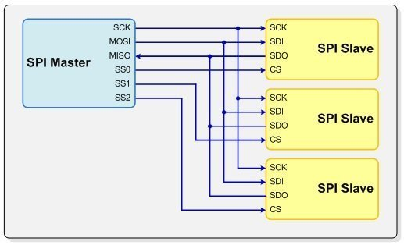
Multi-Salve in SPI

Slide 26
SPI in KL-25z
The serial peripheral interface (SPI) module provides for full-duplex, synchronous, serial communication between the MCU and peripheral devices. These peripheral devices can include other microcontrollers, analog-to-digital converters, shift registers, sensors, and memories, among others.
In Kl-25z SPI has three Modes of Operation
The SPI functions in three modes, run, wait, and stop.
Run Mode
Wait Mode
Stop Wait

Slide 27
SPI Block Diagram

Slide 28
I2C COMMUNICATION
I2C combines the best features of SPI and UARTs. With I2C, you can connect multiple slaves to a single master (like SPI) and you can have multiple masters controlling single, or multiple slaves.
This is really useful when you want to have more than one microcontroller logging data to a single memory card or displaying text to a single LCD.

Slide 29
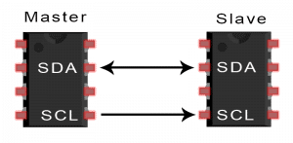
I2C COMMUNICATION
SDA (Serial Data) – The line for the master and slave to send and receive data.
SCL (Serial Clock) – The line that carries the clock signal.
I2C is a serial communication protocol, so data is transferred bit by bit along a single wire (the SDA line).
Like SPI, I2C is synchronous, so the output of bits is synchronized to the sampling of bits by a clock signal shared between the master and the slave. The clock signal is always controlled by the master.

Slide 30
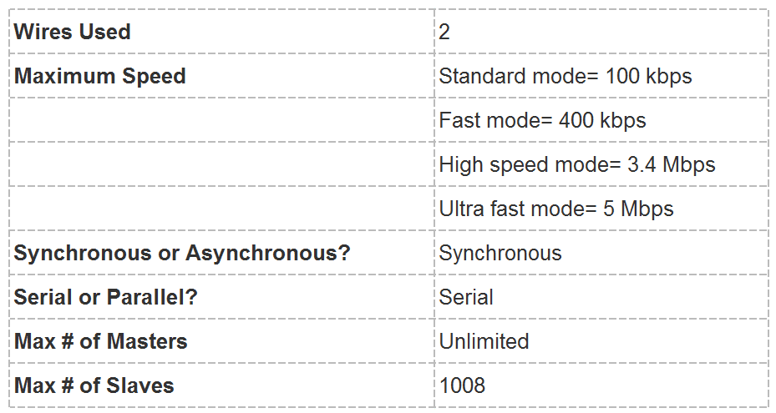
I2C Features

Slide 31
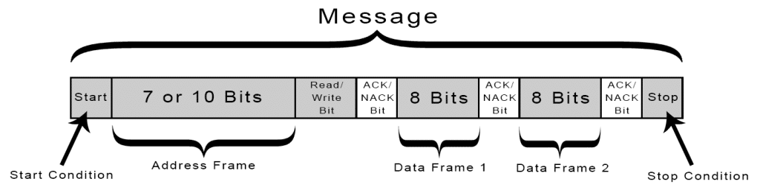
I2C WORKING
Start Condition: The SDA line switches from a high voltage level to a low voltage level before the SCL line switches from high to low.
Stop Condition: The SDA line switches from a low voltage level to a high voltage level after the SCL line switches from low to high.
Read/Write Bit: A single bit specifying whether the master is sending data to the slave (low voltage level) or requesting data from it (high voltage level).
ACK/NACK Bit: Each frame in a message is followed by an acknowledge/no-acknowledge bit. If an address frame or data frame was successfully received, an ACK bit is returned to the sender from the receiving device.

Slide 32
I2C IN KL-25z
The inter-integrated circuit (I2C) module provides a method of communication between a number of devices. The interface is designed to operate up to 100 kbit/s with maximum bus loading and timing. The I2C device is capable of operating at higher baud rates, up to a maximum of clock/20, with reduced bus loading.
I2C module has the following features:
Compatible with The I2C-Bus Specification
Multimaster operation
Software programmable for one of 64 different serial clock frequencies
Software-selectable acknowledge bit
Interrupt-driven byte-by-byte data transfer
Arbitration-lost interrupt with automatic mode switching from master to slave
Calling address identification interrupt
START and STOP signal generation and detection
Repeated START signal generation and detection
Acknowledge bit generation and detection
Bus busy detection
General call recognition

Slide 33
I2C Modes of operation in KL-25z
The I2C module's operation in various low power modes is as follows:
• Run mode: This is the basic mode of operation. To conserve power in this mode, disable the module.
• Wait mode: The module continues to operate when the core is in Wait mode and can provide a wakeup interrupt.
• Stop mode: The module is inactive in Stop mode for reduced power consumption, except that address matching is enabled in Stop mode. The STOP instruction does not affect the I2C module's register states.

Slide 34
Block diagram I2C in KL-25z

Slide 35
MMA8451 on Freedom KL25Z
The MMA8451 is a smart, low-power, three-axis, capacitive, micromachined accelerometer with 14 bits of resolution.
This accelerometer is packed with embedded functions with flexible user programmable options, configurable to two interrupt pins. Embedded interrupt functions allow for overall power savings relieving the host processor from continuously polling data

Slide 36
MMA8451 Features
• 1.95 V to 3.6 V supply voltage
• 1.6 V to 3.6 V interface voltage
• ±2 g/±4 g/±8 g dynamically selectable full scale
• Output data rates (ODR) from 1.56 Hz to 800 Hz
• 99 μg/√Hz noise
• 14-bit and 8-bit digital output
• I2C digital output interface
• Two programmable interrupt pins for seven interrupt sources
• Three embedded channels of motion detection — Freefall or motion detection: one channel — Pulse detection: one channel — Jolt detection: one channel
• Orientation (portrait/landscape) detection with programmable hysteresis
• Automatic ODR change for auto-wake and return to sleep
• 32-sample FIFO • High-pass filter data available per sample and through the FIFO
• Self-test • Current consumption: 6 μA to 165 μA

Slide 37
MMA8451
MMA8451 orientations are defined as the following:
PU = portrait up,
LR = landscape right,
PD = portrait down,
LL = landscape left, back and front side views.
There are several registers to configure the orientation detection.

Slide 38
Smart street lighting system using ARM based Microcontroller
A smart street light system incorporates a cluster of streetlight lamps that can communicate with each other and provide lighting data to a local concentrator. It allows facility managers to remotely control street lights while keeping track of electrical power consumption in the lamps and in the driving circuits.
Advantages of Smart street lighting system:
Increased citizen satisfaction
Reduced energy cost
Increased revenue opportunities

Slide 39
Smart street lighting system using ARM based Microcontroller
Aim:
Lighting for cities is costly, with energy and maintenance costs accounting for approximately 40 percent of its budgets.
Transitioning to Intelligent street lighting represents a huge opportunity for municipalities to not only save a substantial amount of money on energy and maintenance costs, but also become a smart city and offer the platforms to create opportunities for effective and productive engagement with its citizens, businesses, and visitors.
This project aims for designing and implementation of the advanced Internet of Things system for energy saving of street lights.
Currently project have a manual system where the street lights will be switched ON in the evening before the sunsets and they are switched OFF in the next day morning after there is sufficient light on the outside.
But the actual timing for these lights to be switched ON is when there is absolute darkness. With this, the power will be wasted up to some extent.
This project gives solution for electrical power wastage and also the manual operation of the lighting system is completely eliminated.

Slide 40
Smart street lighting system using ARM based Microcontroller
Working
The proposed IoT based system provide a solution for energy saving. project use IR sensor, Light Intensity sensor and NodeMCU (ESP8266) board to design an intelligent system.
project use IR sensor for detecting vehicles on the road, Light sensor for detecting light intensity. Based on vehicles present on the road and light intensity, project control street lights.
project can automatically ON/OFF lights or project can control brightness of the lights.
project use Blynk cloud and Blynk app for displaying the status of the lights.
This project is implemented with wifi based board Node MCU (ESP866) which controls the street lights based on detection of vehicles or any other obstacles on the street.
Whenever the obstacle is detected on the street within the specified time the light will get automatically ON/OFF according to the obstacle detection and the same information can be accessed through internet.
The real time information of the street light (ON/OFF status) can be accessed from anytime, anywhere on the real time dashboard.

Slide 41
Smart street lighting system using ARM based Microcontroller
Components Required
NodeMCU (esp8266)
IR Sensors
LDR Sensor
LED’s
Software used
Arduino IDE
ThingSpeak

Slide 42
Smart street lighting system using ARM based Microcontroller

Slide 43
Smart street lighting system using ARM based Microcontroller: Coding Explanation
Step 1: First include all the required libraries.
#include <ESP8266WiFi.h>;
#include <WiFiClient.h>;
#include <ThingSpeak.h>;
Step 2: Replace SSID and password given in code with you Wi-Fi SSID and password
const char* ssid = "UniSZA-WiFi";
const char* password = "unisza2016";
Step 3: Copy channel number, read and write API keys from ThingSpeak as shown below
unsigned long myChannelNumber = 1778641;
const char * myWriteAPIKey = "CBWL1EPYK078WV49";
const char * myReadAPIKey = "HS82229EGKQ9IO2O";
Step 4: Define variable for GPIO pins of leds and IR sensors, ADC channel
int ir1 = D0;
int led1 = D5;
int ir2 = D1;
int led2 = D6;
int ir3 = D2;
int led3 = D7;
int ldr = A0;
int val =0;
Step 5: Set the pinMode for pins of led and IR sensor on the NodeMCU
pinMode(ir1,INPUT);
pinMode(led1,OUTPUT);
pinMode(ir2,INPUT);
pinMode(led2,OUTPUT);
pinMode(ir3,INPUT);
pinMode(led3,OUTPUT);

Slide 44
Smart street lighting system using ARM based Microcontroller: Coding Explanation
Step 6: Initialization of Wi-Fi and ThingSpeak
WiFi.begin(ssid, password);
ThingSpeak.begin(client);
Step 7: Now we take digital value of the IR sensors and analog value of LDR sensor and store them in variables.
int s1 = digitalRead(ir1);
int s2 = digitalRead(ir2);
int s3 = digitalRead(ir3);
int l1 = digitalRead(led1);
int l2 = digitalRead(led2);
int l3 = digitalRead(led3);
val = analogRead(ldr);
Step 8: Initialize back the declaration of IR, LDR sensor reading and led to display at the serial monitor
Serial.print(s1);
Serial.print(":");
Serial.print(s2);
Serial.print(":");
Serial.print(s3);
Serial.print(":");
Serial.print(l1);
Serial.print(":");
Serial.print(l2);
Serial.print(":");
Serial.print(l3);
Serial.print(" ");
Serial.println(val);

Slide 45
Smart street lighting system using ARM based Microcontroller: Coding Explanation
Step 9: Now check the value of LDR sensor for low light. Here we have set value as 200 means if the analog value of LDR is lower than 200 then it will be night time or low light and hence it will turn on the led if IR sensors detect some obstacle or motion. If the analog value of the LDR sensor is more than 200 then it will be considered as daytime and LEDs will not glow even if IR sensor detects someone passing the street.
if(val<=200) {
if(s1==0) {
digitalWrite(led1,HIGH); }
else {
digitalWrite(led1,LOW); }
if(s2==0) {
digitalWrite(led2,HIGH); }
else {
digitalWrite(led2,LOW); }
if(s3==0) {
digitalWrite(led3,HIGH); }
else {
digitalWrite(led3,LOW); }
}
else {
digitalWrite(led1,LOW);
digitalWrite(led2,LOW);
digitalWrite(led3,LOW); }
Step 10: Finally upload the data on the ThingSpeak cloud by using function ThingSpeak.writeField(). It take channel number, field number, data (you want to upload in respective field) and write API key. Here we are uploading LDR sensor data, IR sensors data and LEDs data to the ThingSpeak cloud.
ThingSpeak.writeField(myChannelNumber, 1,val, myWriteAPIKey);
ThingSpeak.writeField(myChannelNumber, 2,s1, myWriteAPIKey);
ThingSpeak.writeField(myChannelNumber, 3,s2, myWriteAPIKey);
ThingSpeak.writeField(myChannelNumber, 4,s3, myWriteAPIKey);
ThingSpeak.writeField(myChannelNumber, 5,digitalRead(led1), myWriteAPIKey);
ThingSpeak.writeField(myChannelNumber, 6,digitalRead(led2), myWriteAPIKey);
ThingSpeak.writeField(myChannelNumber, 7,digitalRead(led3), myWriteAPIKey);

Slide 46
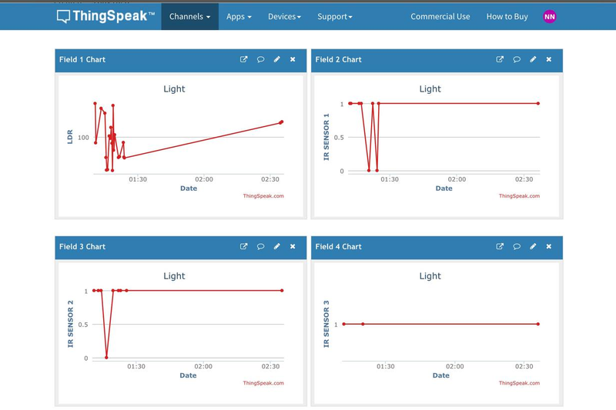
Visualize the Graph Output in ThingSpeak

Slide 47
Sample MCQ
1. The serial communication is a) cheaper communication b) requires less number of conductors c) slow process of communication d) all of the mentioned
2. The serial communication is used for a) short distance communication b) long distance communication c) short and long distance communication d) communication for a certain range of distance
3. The mcs 51 architecture supports a) serial transmission and reception b) simultaneous transmission and reception c) transmission and reception of data using serial communication interface d) all of the mentioned
4. The number of bits transmitted or received per second is defined as a) transmission rate b) reception rate c) transceiver rate d) baud rate
5. The task of converting the byte into serial form and transmitting it bit by bit along with start, stop and parity bits is carried out by a) reception unit b) serial communication unit c) transmission unit d) all of the mentioned
6. The transmission unit does not require assistance from processor if once a byte for transmission is written to a) SCON register b) SBUF register c) SFR address d) Any of the mentioned
7. The common unit shared by the receiver unit and transmission unit of serial communication unit is a) SCON(Serial Port Control) Register b) SBUF(Serial Buffer) register c) 8-bit serial data interface d) All of the mentioned
8. During serial reception, the buffer that receives serial bits and converts to a byte is a) receive buffer 0 b) receive buffer 1 c) receive buffer 2 d) none
9. If SM0=1, SM1=0, then the transceiver selected is a) 8-bit synchronous b) 9-bit synchronous c) 8-bit asynchronous d) 9-bit asynchronous
10. If the microcontroller is expected to communicate in a multiprocessor system, then the required condition is a) SM0 is set b) SM1 is set c) SM2 is set d) REN is set

Slide 48
Thank You

